Slide 1
STAT 380 Final Project
Stephen Polacheck // Vince Birch

Slide 2



Motivation

Slide 3



Methods

Slide 4
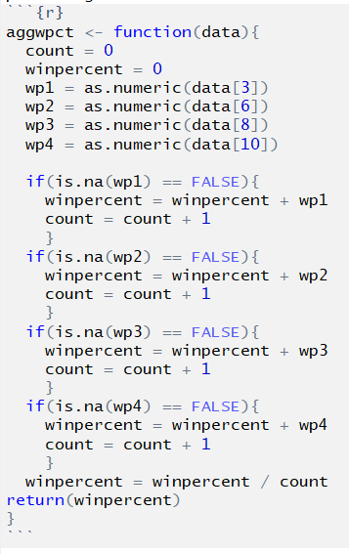

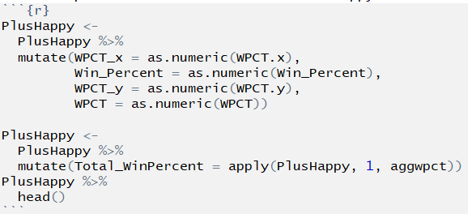
Methods

Slide 5



Obstacle

Slide 6
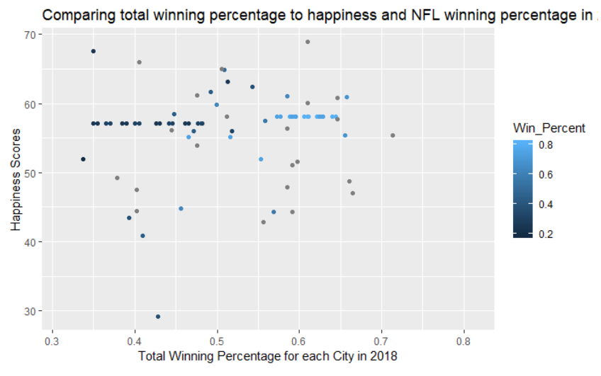
Results

Slide 7
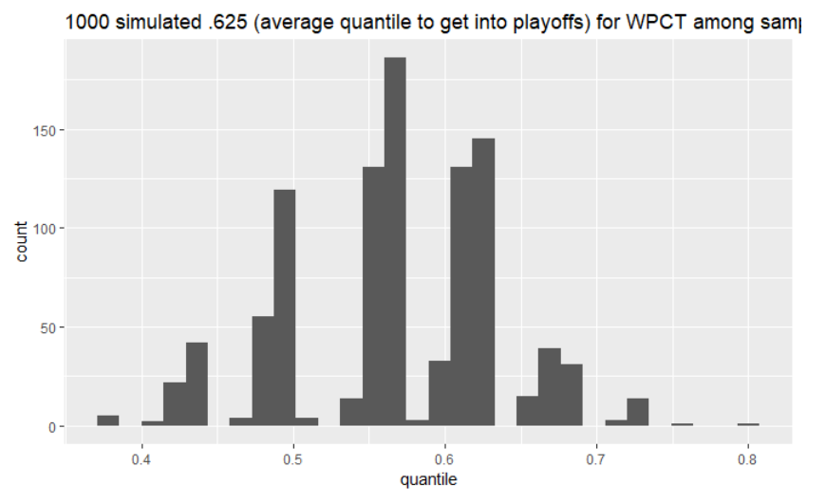
Results

Slide 8
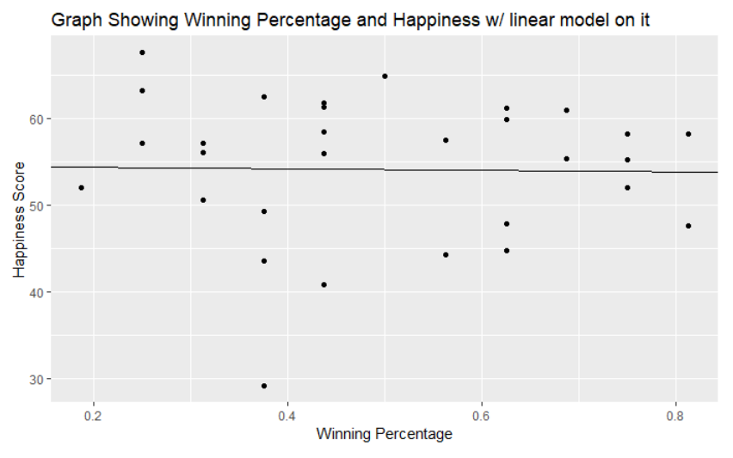
Results

